Slide 1

CS 449 Rec
cache

Slide 2

Announcements
HW 6 is out
Due Nov. 6
Cache lab is out
Due Nov. 12

Slide 3
Schedule
Cache review
Quizzes for the lab
Cache tracing
Next week: Cache lab

Slide 4
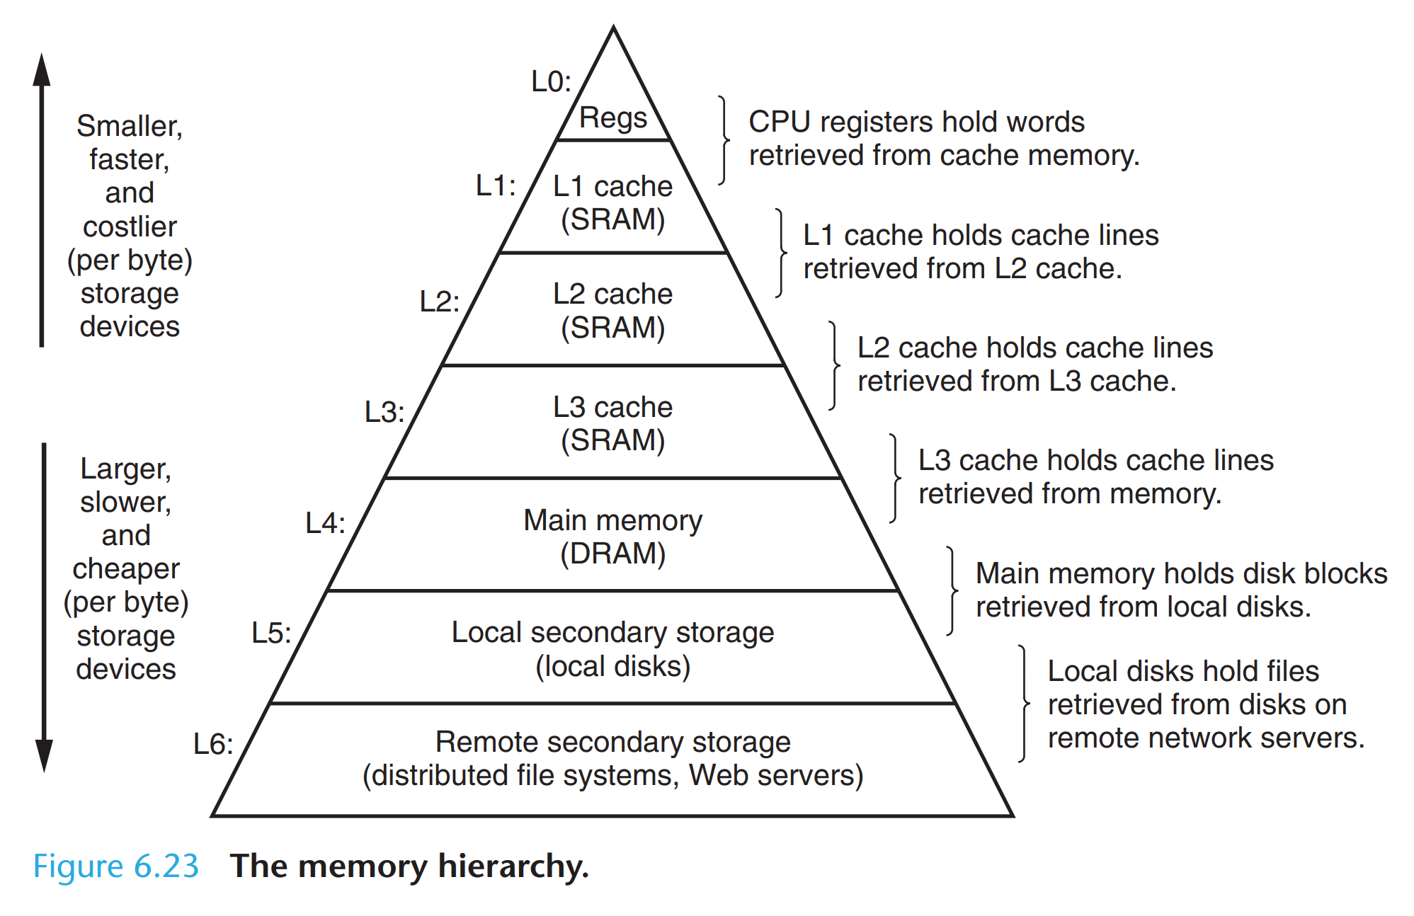
(from textbook)

Slide 5
Cache review (from lecture)

Slide 6
Cache basics
Cache -> sets -> lines -> blocks (with bytes)
Address of words: | t bits | s bits | b bits |
| tag | set index | block offset |
Word size = t+s+b
2^(t+s+b) addresses
How to locate data?

Slide 7
(from lecture)

Slide 8
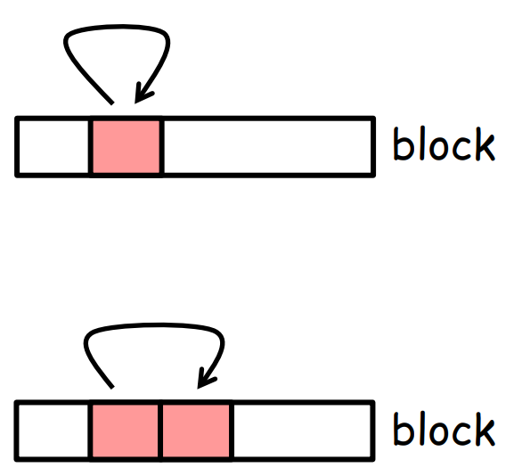
Locality
Temporal
a memory location that is referenced once is likely to be referenced again multiple times in the near future
Repeated references to variables are good
Spatial
the program is likely to reference a nearby memory location in the near future
Stride-1 reference patterns are good

Slide 9
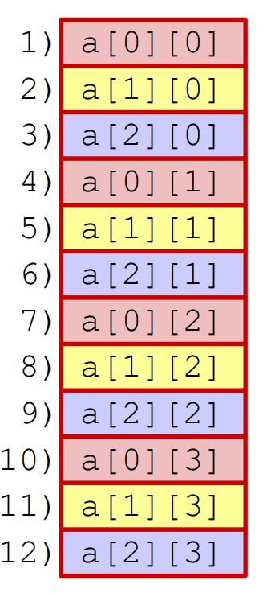
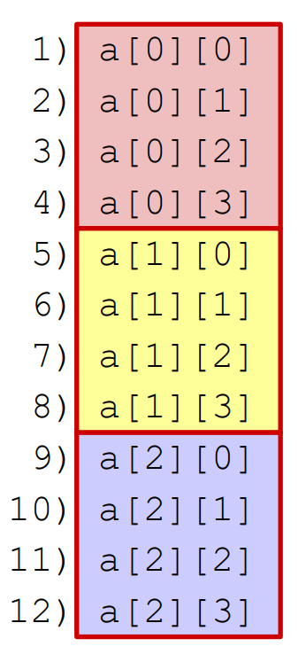
References (spatial locality)
VS

Slide 10
Hit/Miss
Hit Rate (HR) = hits/accesses
Miss Rate (MR) = misses/accesses = 1 - Hit Rate
Hit Time (HT) = Time to deliver a block in the cache to the processor
Includes time to check hit/miss
Miss Penalty (MP) = Additional time required because of a miss
Average Memory Access Time (AMAT) = HT + MR × MP

Slide 11
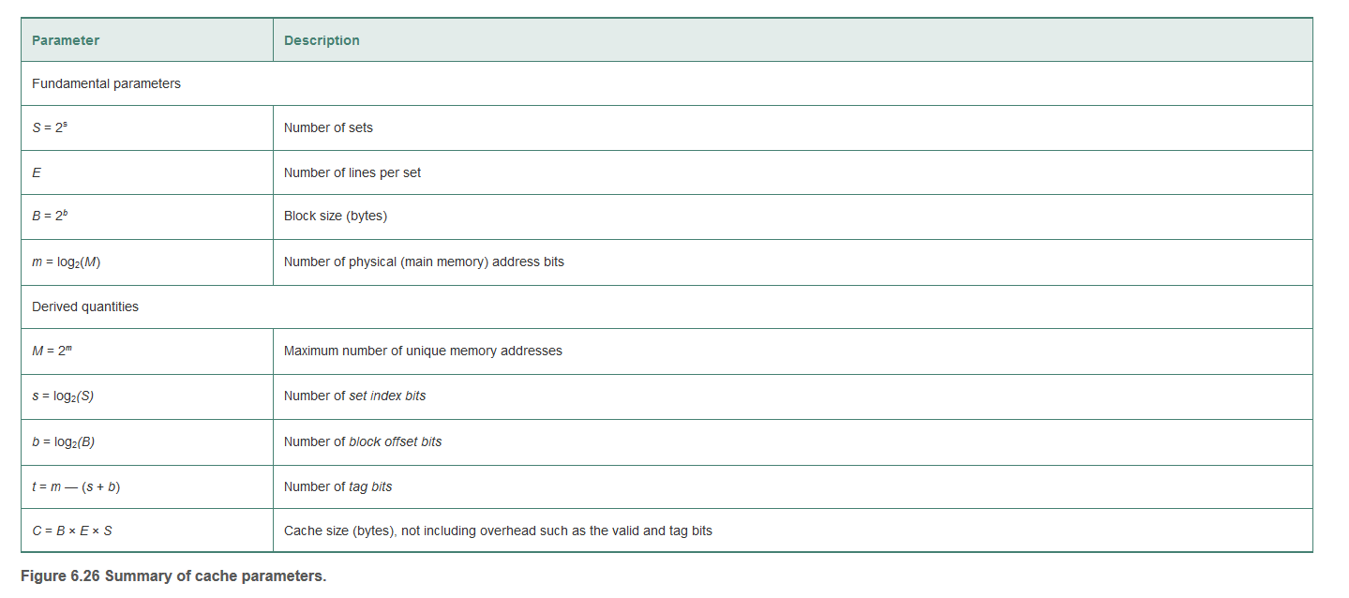
(from textbook)

Slide 12
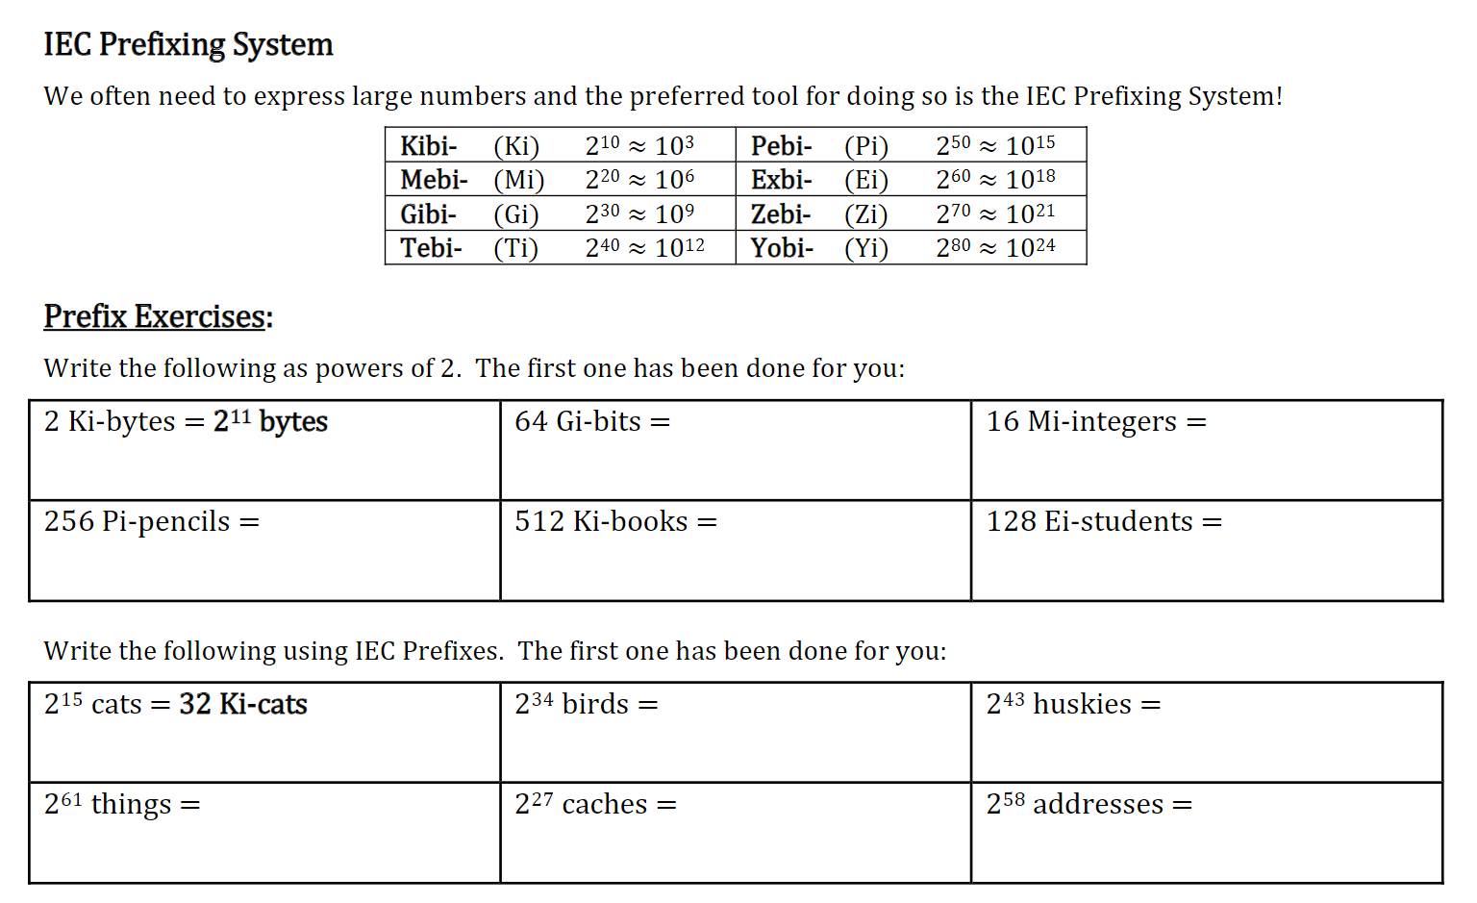
Quizzes

Slide 13
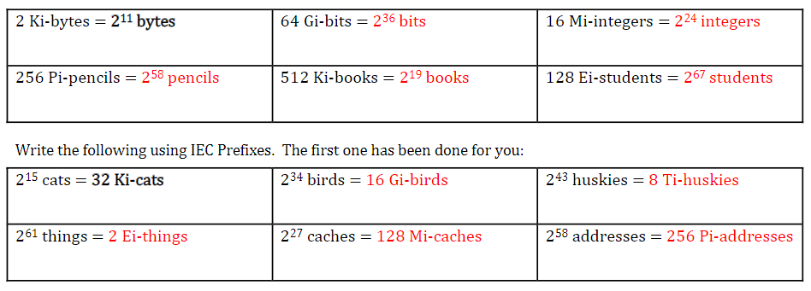

Slide 14
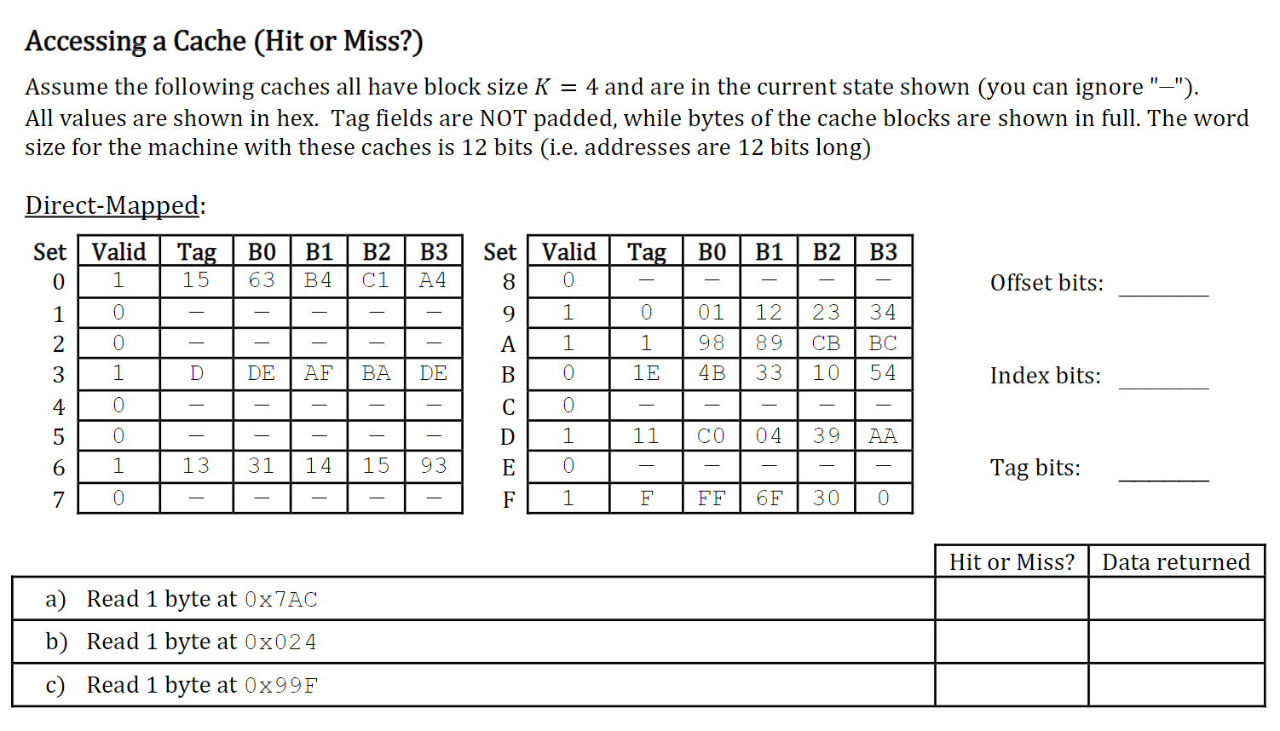
Direct mapped

Slide 15
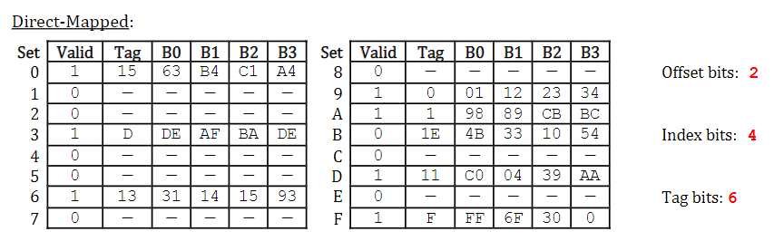
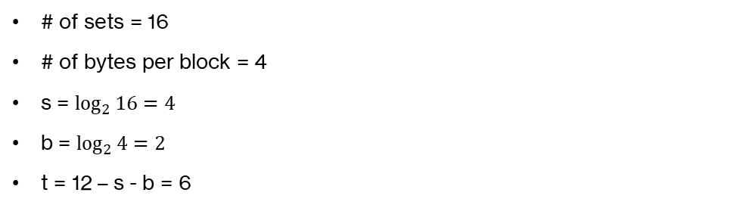
Answer
# of sets = 16
# of bytes per block = 4
s = $\log_{2}{16}=4$
b = $\log_{2}{4}=2$
t = 12 – s - b = 6

Slide 16
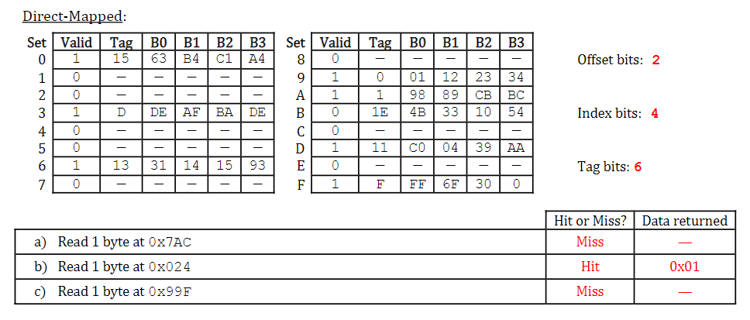
Answer
t = 1E; s = B; b = 0
t = 0; s = 9; b = 0
t = 26; s = 7; b = 3

Slide 17
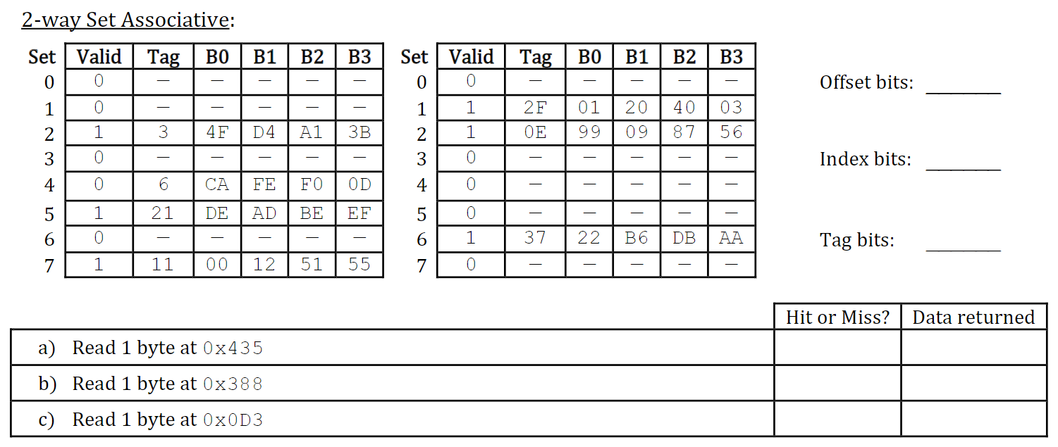
2-way Set Associative

Slide 18
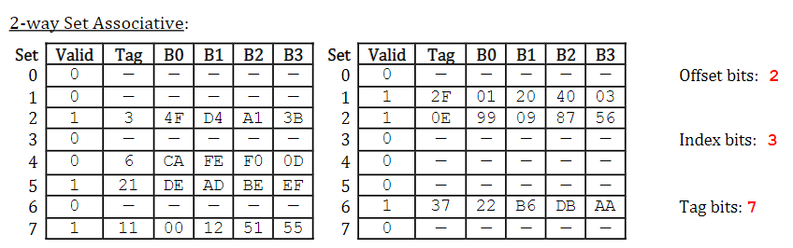
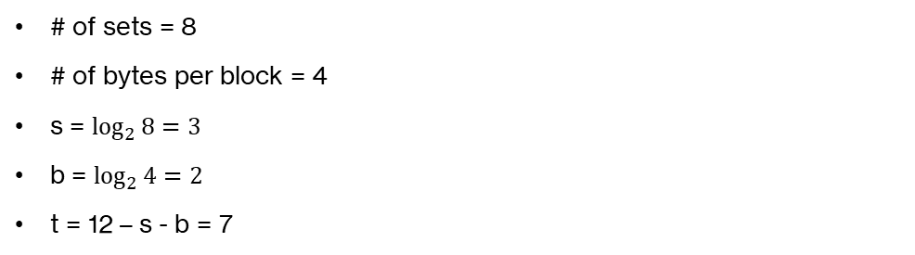
Answer
# of sets = 8
# of bytes per block = 4
s = $\log_{2}{8}=3$
b = $\log_{2}{4}=2$
t = 12 – s - b = 7

Slide 19
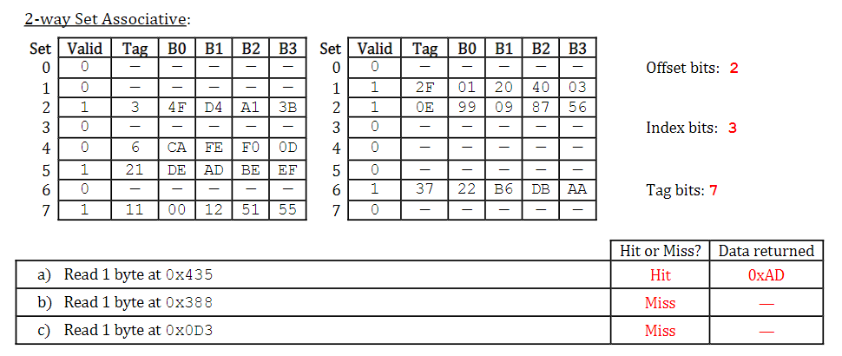
Answer
t = 21; s = 5; b = 1
t = 1C; s = 2; b = 0
t = 6; s = 4; b = 3

Slide 20
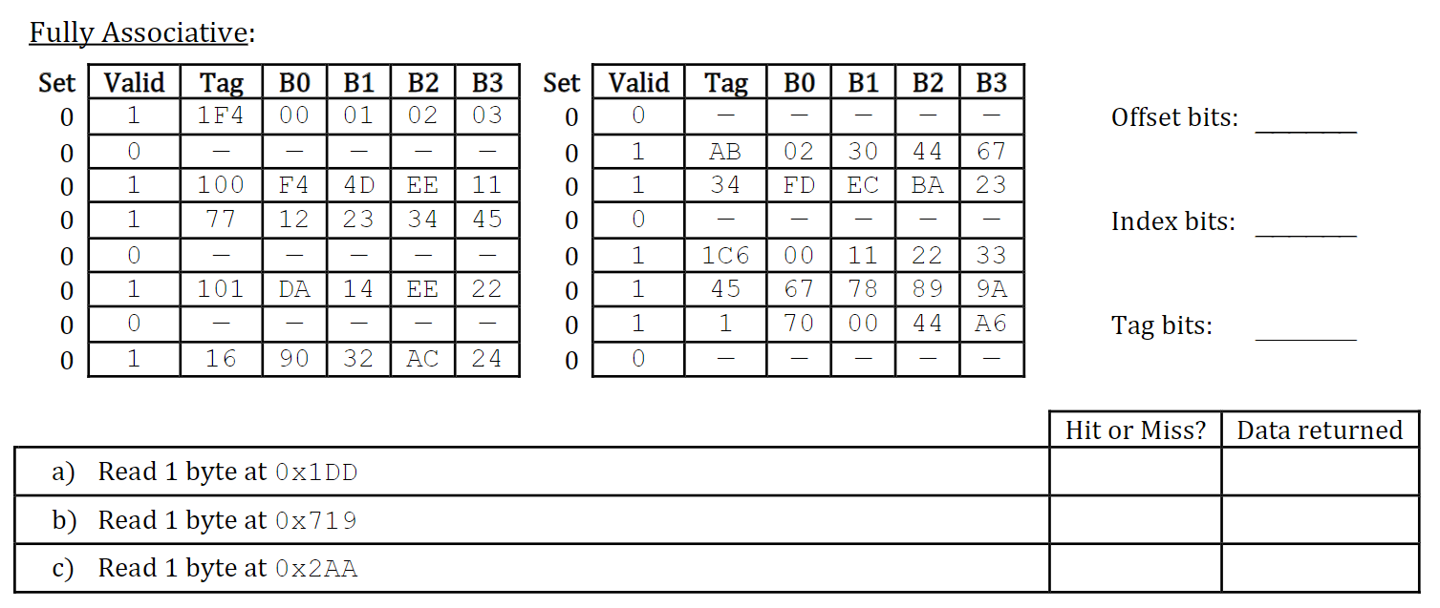
Fully Associative

Slide 21
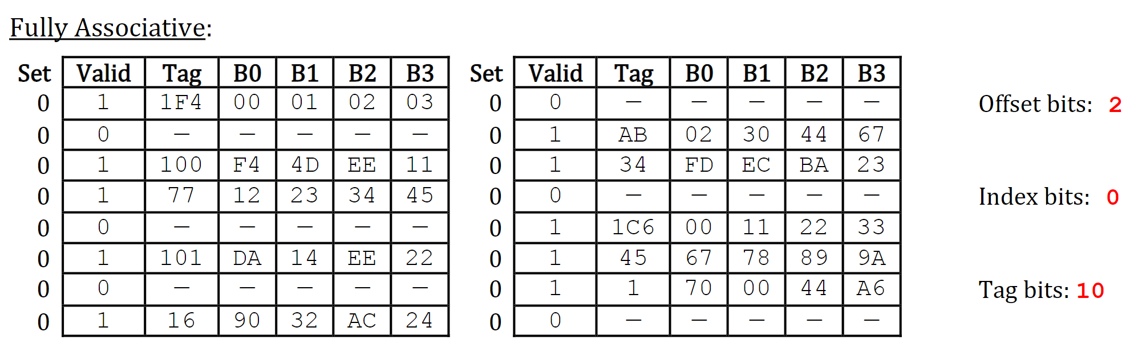
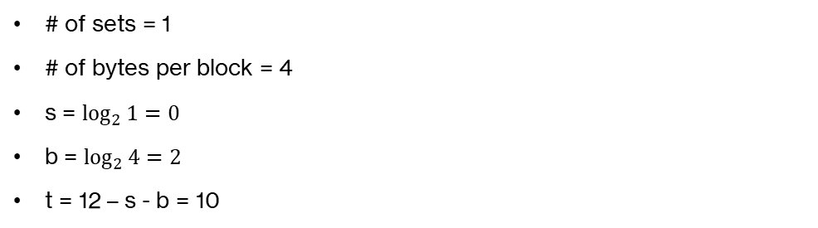
Answer
# of sets = 1
# of bytes per block = 4
s = $\log_{2}{1}=0$
b = $\log_{2}{4}=2$
t = 12 – s - b = 10

Slide 22
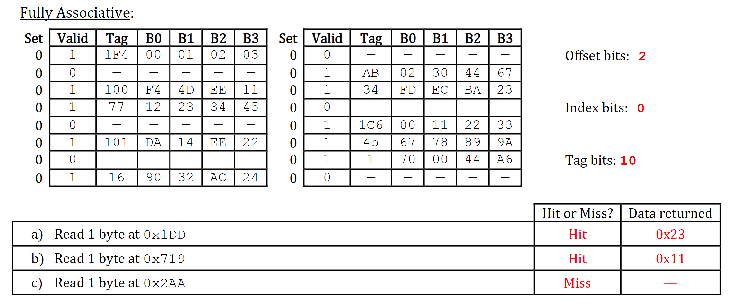
Answer
t = 77; s = 0; b = 1
t = 1C6; s = 0; b = 1
t = AA; s = 0; b = 2

Slide 23
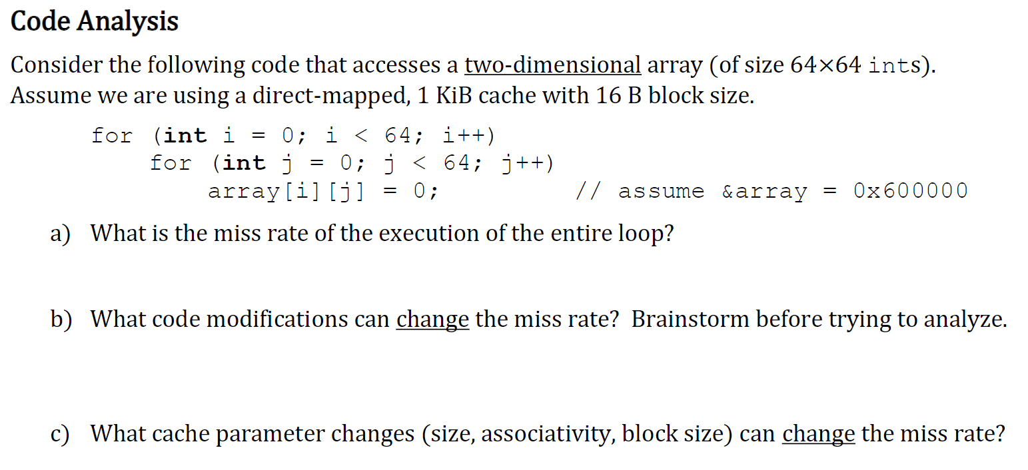
Miss rate

Slide 24
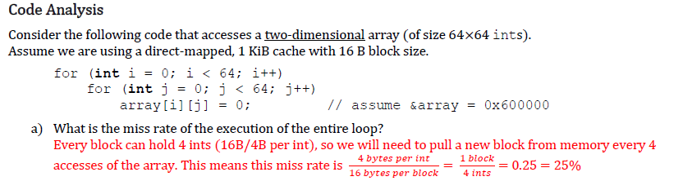
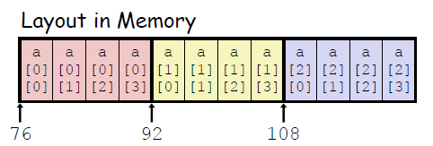
Assume cache starts empty
Remember how 2D arrays are laid out in memory (image from lecture slides, for a 3 x 4 array). The miss rate would be higher if we iterated through rows in each column.
Miss rate = #misses/#references, we’ll miss once for every 4 ints we read in

Slide 25
See comments on loop switching on previous slide
Switching to a narrower/wider datatype would imply that more/fewer values would fit within each block, implying a lower/higher miss rate.
Linked lists would make the situation less predictable (memory locations might not be contiguous…)

Slide 26
Summary: A larger cache won’t improve the miss rate, since we need to fetch each new block regardless.

Slide 27
Summary: Since we’re moving through contiguous locations in memory, the new blocks will map onto different sets (switching to 2-way associative would make more of a difference if we were frequently pulling in blocks with conflicting set indices).

Slide 28
Summary: Larger blocks → less frequent fetches from lower levels of memory hierarchy → lower miss rate.

Slide 30
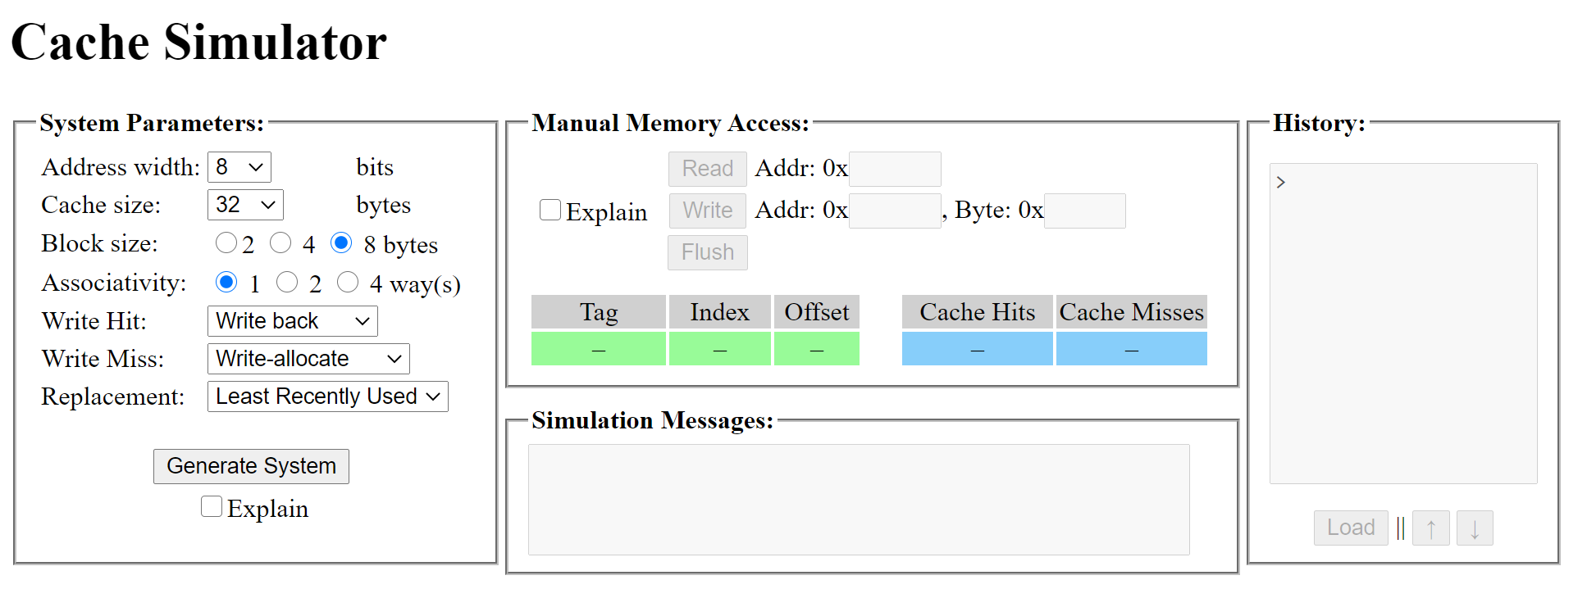
Cache Simulator
https://www.cs.pitt.edu/~vinicius/cachesim/

Slide 31
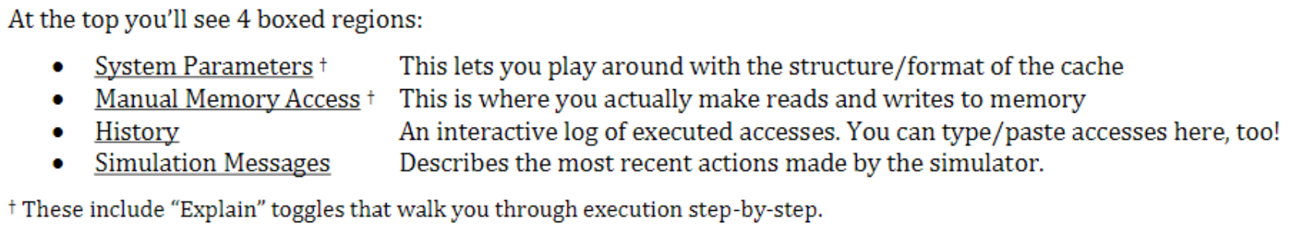
Cache Simulator
https://www.cs.pitt.edu/~vinicius/cachesim/

Slide 32
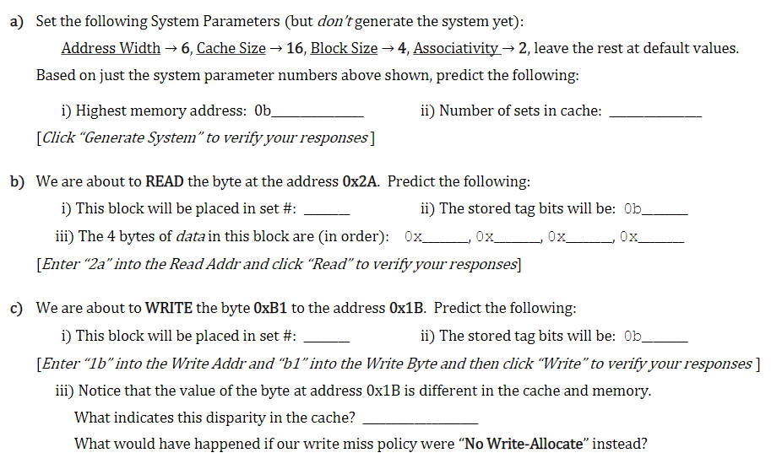
Practice questions

Slide 33
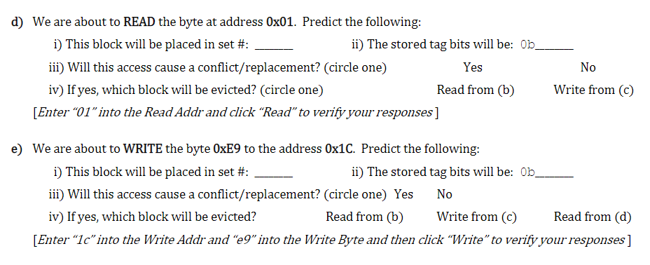
(cont.)

Slide 34
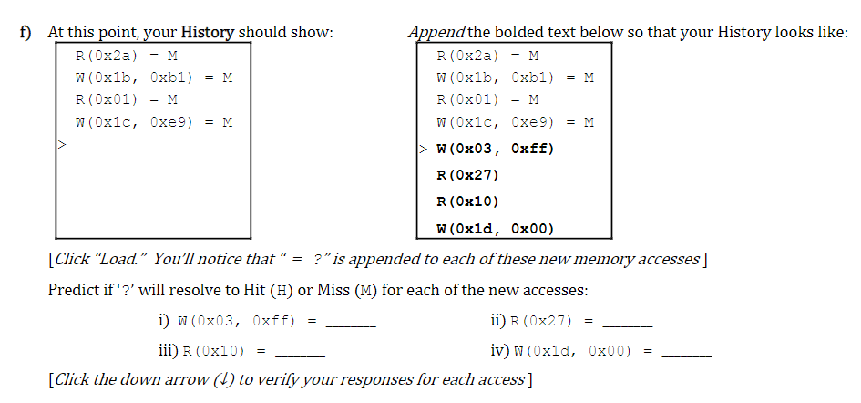
(cont.)

Slide 35
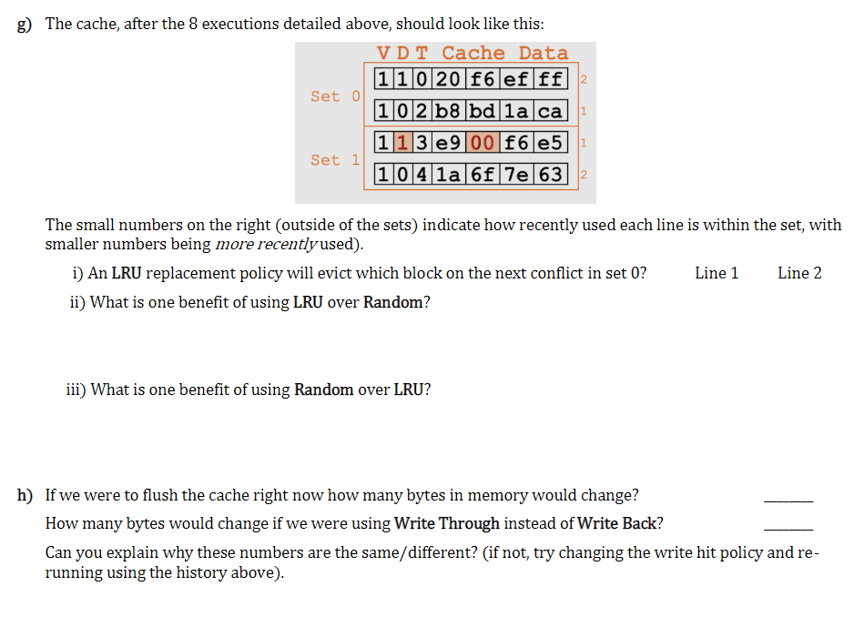
(cont.)

Slide 36
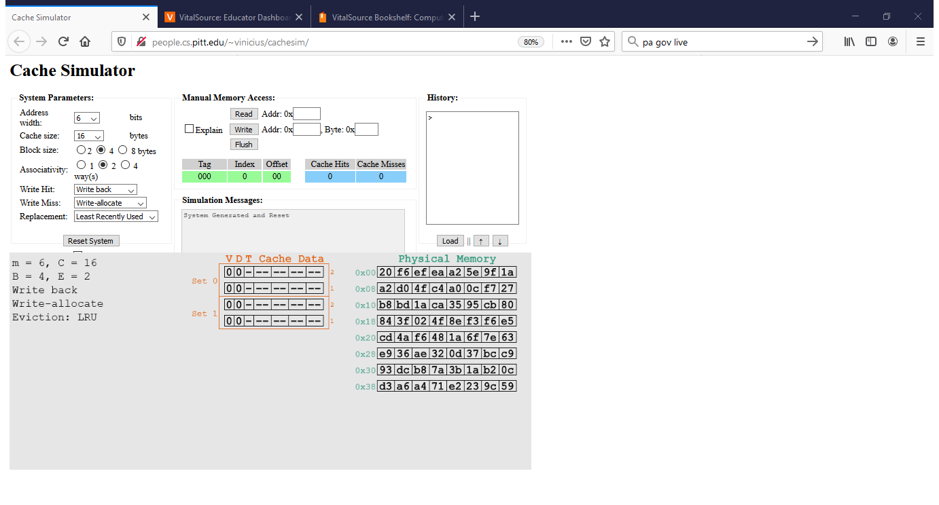

Slide 37
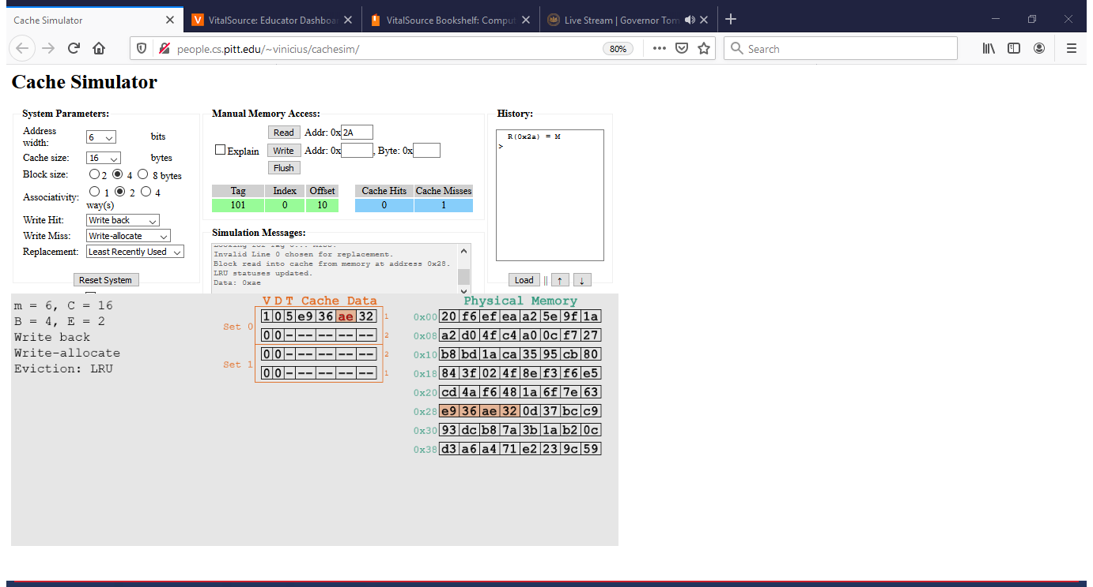

Slide 38
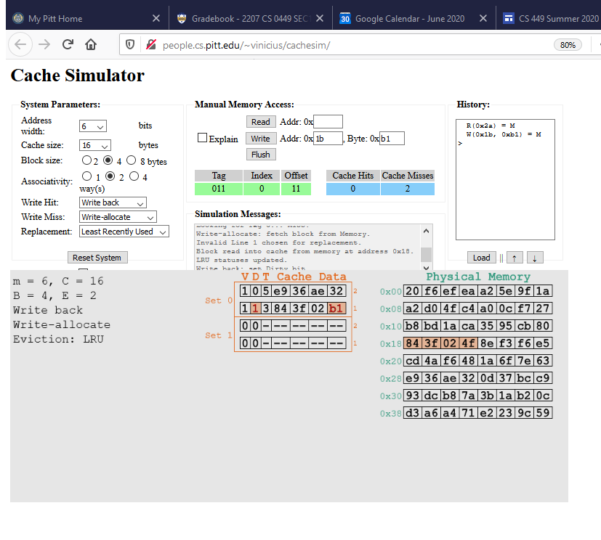

Slide 39
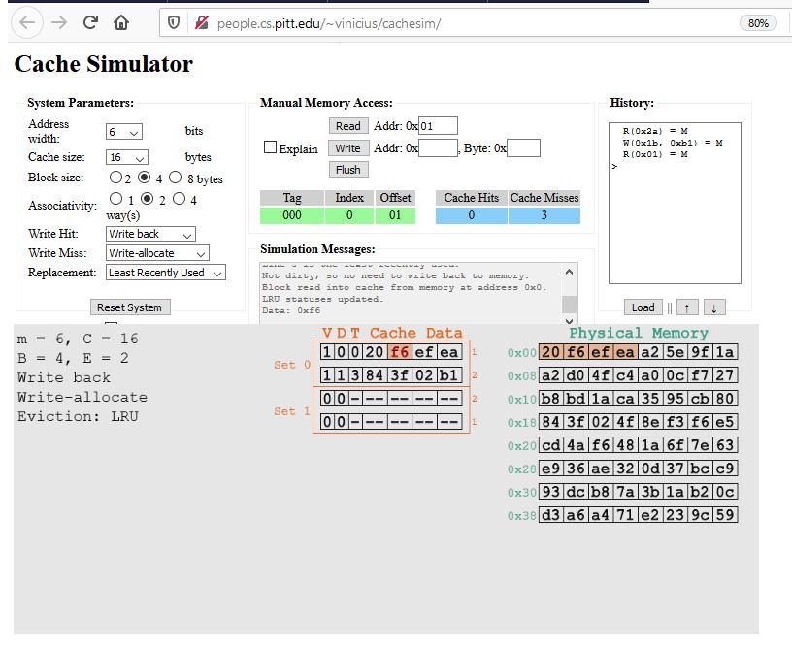

Slide 40
Cache tracing
Load vs Store
L: from memory to cache (read)
S: from cache to memory (write)
Trace file (.trace); e.g. L 0,4 S 8,4

Slide 41
Example

Slide 42
(Summary from lecture)
Memory Hierarchy
Successively higher levels contain “most used” data from lower levels
Exploits temporal and spatial locality
Caches are intermediate storage levels used to optimize data transfers between any system elements with different characteristics
Cache Performance
Ideal case: found in cache (hit)
Bad case: not found in cache (miss), search in next level
Average Memory Access Time (AMAT) = HT + MR × MP
Hurt by Miss Rate and Miss Penalty

